Slide 1
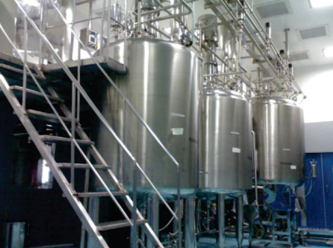
OINTMENT CREAM, TOOTHPASTE MANUFACTURING PLANT
Mfg.& Exp. Of Plants & Machineries for Pharmaceuticals,
Cosmetics, Chemicals food & Beverage Industries
Plot No. 1601/1,3rd Phase G.I.D.C., Vapi-396195. (Gujarat)
Email:sales@sidhipharmaequiment.com:sidhipharmaequipments@gmail.com:
Contact Person : Mr. Pravin Panchal (9924893790) Mr. Kiran Gophane (9545868896)
Website: www.sidhipharmaequipment.com

Slide 2
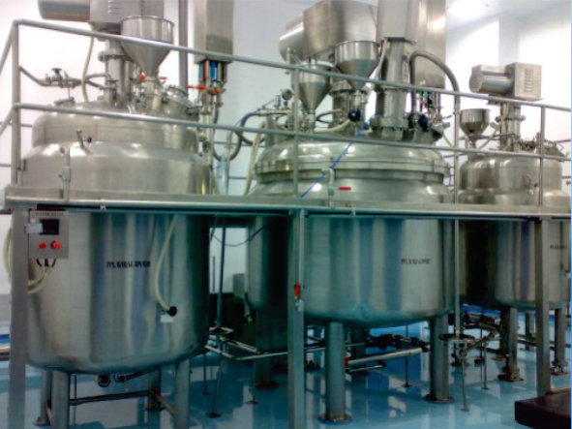
OINTMENT CREAM, TOOTHPASTE MANUFACTURING PLANT
The Ointment Manufacturing Plants are idol tools for the Pharmaceutical & cosmetic industries for the production of ointment, Cream, Lotions, Tooth Paste & other emulsions & homogenizations. It is specially designed to take care of two critical factors Which directly affects the quality of the Ointment / Creams. Minimum man handling Ointment. Negligible vacuum drop during mixing & blending. Needless to say, it also provides the benefits of the effective manpower utilization.
SIDDHI PHARMA EQUIPMENT’s Ointment consist the following equipments accessories.
Manufacturing Vessel OR Jacketed Planetary Mixer
Wax Phase Vessel
Water Phase Vessel
Storage Vessel
Vacuum Pump
Control Panel
Product Piping Working Platform
Material Transfer Pump to Transfer from manufacturing Vessel OR Planetary material from Vessel & Storage Vessel to Ointment ( Tube ) Filling M / C. ( 02 nos.)

Slide 3
Silent Features :
The Plant is designed to be operated only by one operator and one helper. All material transfers are done by vacuum or by transfer pumps.
All the Vessels are CGMP ( paint free construction .
The gaskets used are of silicon ( food grace ).
All contact parts are of SS 304 quality material ( Ss316 provided on demand ) & finished to class 4B ( Mirror ) finish and are crevice free.
The entry of all agitators are from top & High Speed Emulsifier from bottom or In-Line Emulsifier (as per customer choice ).
All Vessels are suitable for internal pressure of 1 Kg. / sq.cm. and hence can be sterilized. All pipes, pipe fittings and valves are of SS304 / Ss315 ( as per customer requirement ) seamless quality, internally electro polished with tri-clover ended joints.
The entire plant is equipped with CIP % SIP connections, so that customers can use these facility, if have CIP & SIP equipment.
All values of temperature & time of the plant are indicated digitally on the control panel. Ampere indicates on Ampere meters.
A micro processor based automatic operating plant can be designed as per requirement. All the inlet & outlet connections are provided with tri clover joints, which are very easy for cleaning & replacement.
Advantageous\ Benefits :
Mixing , dispersing and homogenizing in one operation.
Homogenous product consistency without trapped air bubbles.
Large variety of products due to the highly flexible dispersing and homogenizing system.
Fast product change over.
Sterile production corresponding to GMP regulations.
Rapid and effective cleaning : CIP / SIP
High capacity with minimal space requirement.
Simple operation.
Can be fully automated.
Integration into existing process control system.

